Slide 1
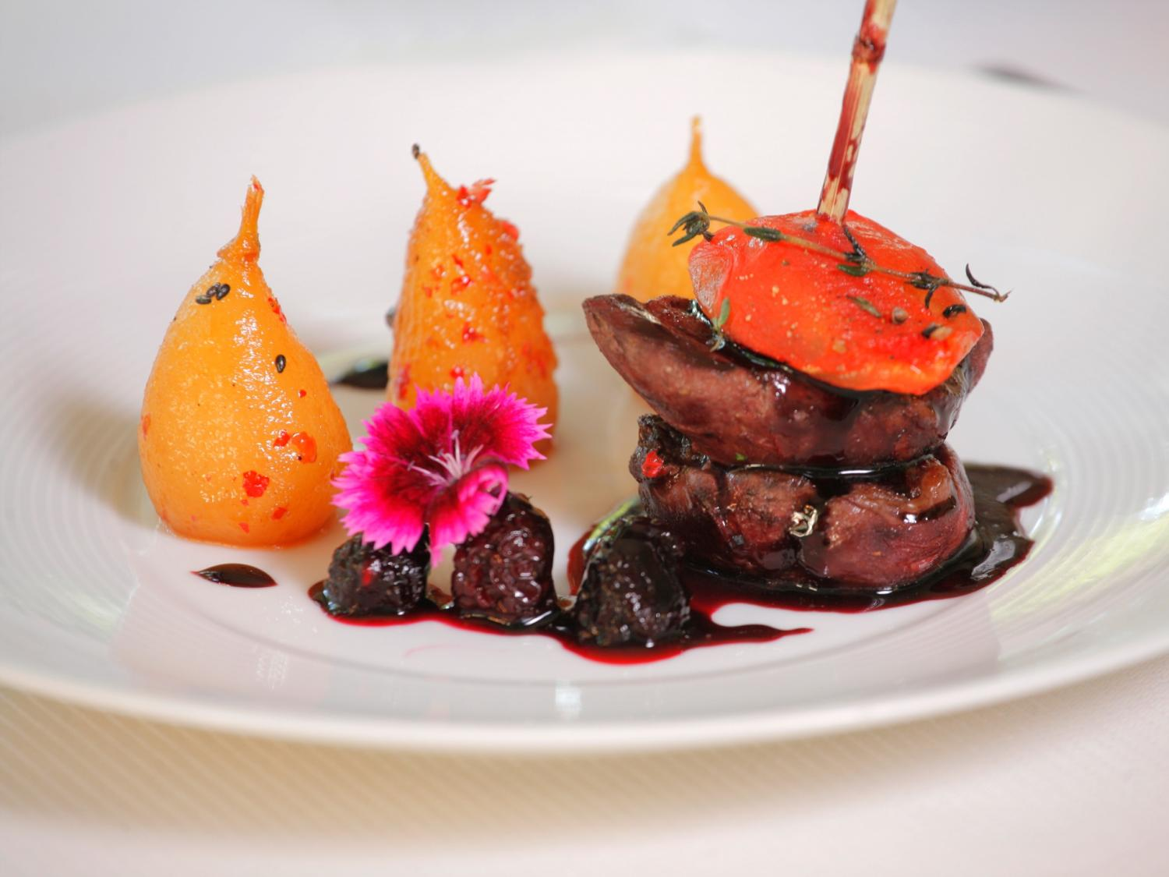
CQRS recipes or how to cook your architecture
@tjaskula

Slide 2
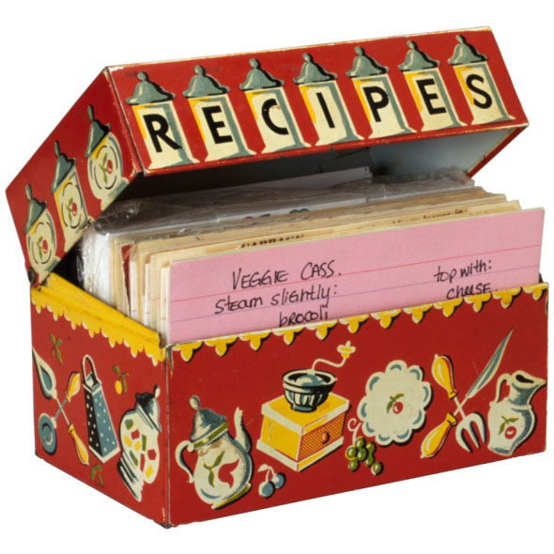
But before we dive into CQRS recipes…
…we have to understand basic layered ones

Slide 3
Maslow pyramid in meal recipes
Not official, just my own trip
Culinary art
Fine food
Home cooking
Fast food and frozen food
Basic ingredients like milk, bread, meat

Slide 4

Hey! How this relates to architecture mate?

Slide 5
Maslow architecture pyramid?
This should somehow map
Culinary art
Fine food
Home cooking
Fast food and frozen food
Basic ingredients like milk, bread, meat
?
?
?
?
?

Slide 6
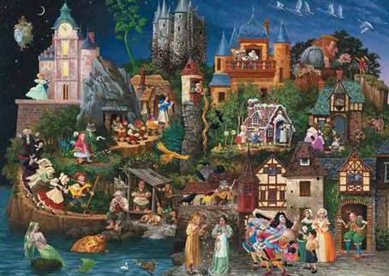
But first let’s tell a little story…
…of one e-commerce application that I’ve learnt so hard

Slide 7

Once upon a time… a marketing team came in
…to announce to developers what they have sold

Slide 8

“We need an e-commerce portal. Now!”
“Do it fast”
“We need every feature Orders, Product catalog, Suppliers”

Slide 9
Development has started…

Slide 10
In progress…

Slide 11


…Then the developer has came after a while…

Slide 12
E-Commerce portal architecture
UI
Domain
DAL
DB

Slide 13
Another feature was asked by the business…

Slide 14


But developers just…

Slide 15

It will take another year. Because we’ve built a…
Notes:
Explain what is monolith

Slide 16
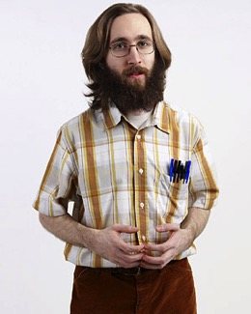
“We need to refactor. Business want’s more features…”
How to refactor a monolith?

Slide 17
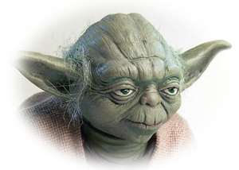
To decouple every component, you have.
Evolve domain independently, it should.
Handle business needs easier, you will.

Slide 18
Decouple components
Handle business logic in isolated domain
Write unit test because every change is a breaking one
We have to think it over, but for now let’s wrap up what we’ve learnt

Slide 19
Lesson learnt 1
Simple architecture, does not scale, hard to maintain, often monolithic
Recipe 1:
Basic layered
architecture

Slide 20
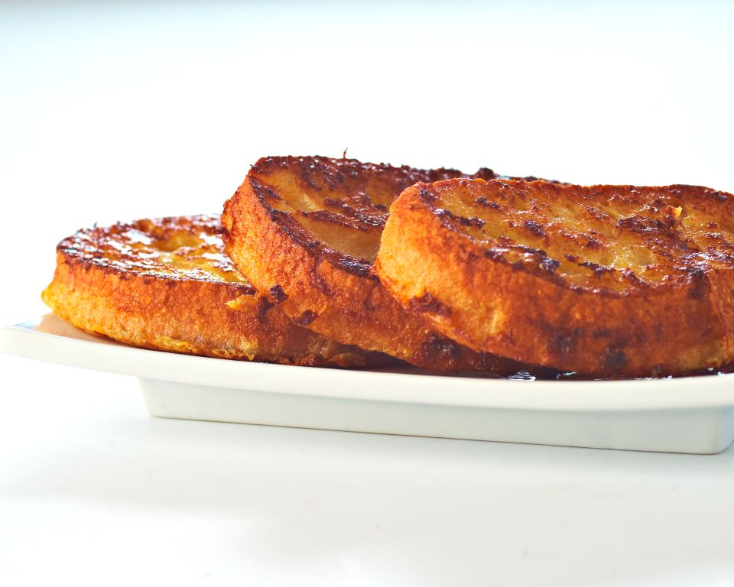
Basic layered architecture
Recipe 1
Difficulty:
Time: from 25 min to infinity
Preparation:
Just throw basic code skills in. Mix it up with a database and UI and everything will be fine…or not…
UI
Domain
Ingredients
Basic coding skills Some infrastructure pieces (DB, etc.)
DAL
DB
Client reviews
Can be set up very quickly Easy to understand No need for experienced developers. Juniors can make it | Leads quickly to unmaintainable monolith code blocks Not easily evolvable for quickly changing business requirements Not scalable Not performent if charge gets bigger Not testable. You’d better have end-to-end integration tests

Slide 21
Where we’ve been?
Ah yeah…DECOUPLING stuff

Slide 22

Then this came in
Let’s decouple ourselves from DB

Slide 23
And decouple us from everything else…
IoC container FTW!

Slide 24
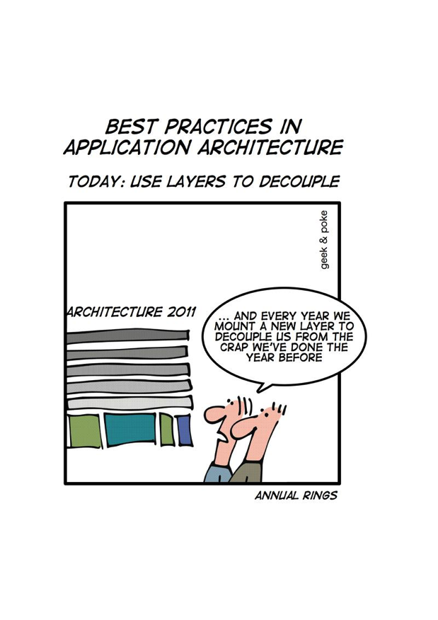
And…

Slide 25
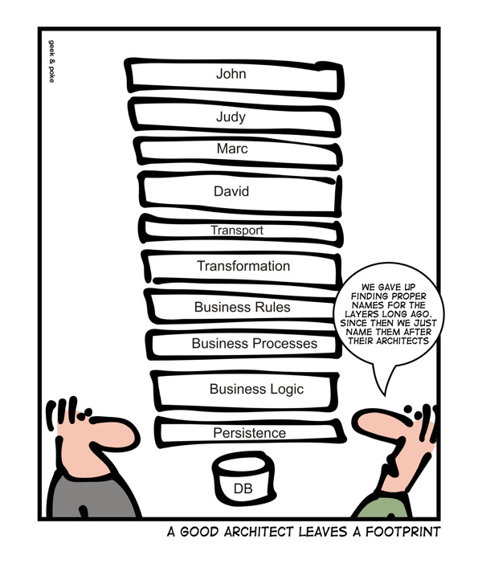
And…

Slide 26
Business ask more futures for Orders, Suppliers, stuff…

Slide 27
Architecture v2
UI
Presentation
OrderController
OrderViewModel
OrderMapper
IOrderMapper
Domain
Order
SqlOrderRepository
IOrderRepository
Infrastructure
DB

Slide 28
What's the problem with n-layered architectures?

Slide 29
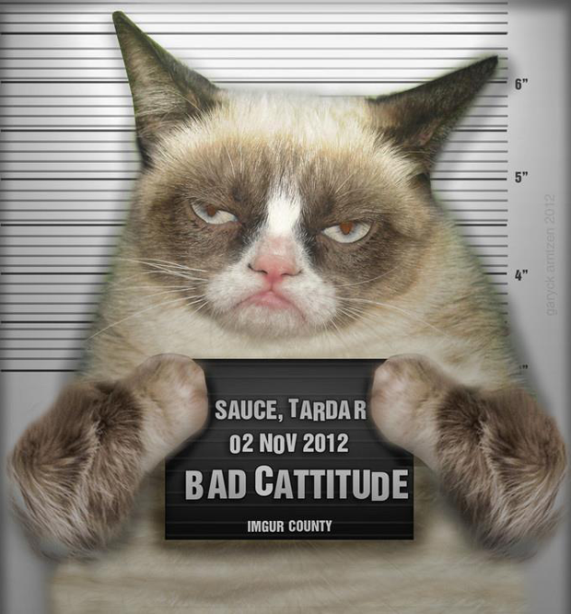
What's the problem with n-layered architectures ?
Reused Abstraction Principle
VIOLATED
Notes:
* RAP principle violated (Reused Abstraction Principle). Interface are not a guarantee of abstraction. We end up with one implementation per interface
* Interfaces should be discovered and not invented.

Slide 30
Over time, more features, more pain…
Notes:
* RAP principle violated (Reused Abstraction Principle). Interface are not a guarantee of abstraction. We end up with one implementation per interface
* Interfaces should be discovered and not invented.

Slide 31
Because of…
public class OrderController {
public OrderController (IOrderValidator order validator,
IOrderMapper orderMapper,
IOrderRepository orderRepository
ISupplierRepository supplierRepository
IAuthorizationFactory authorizationFactory,
IUnitOfWork unitOfWork,
IUserFactory userFactory
ISession session,
ILogger logger,
IOrderCache orderCache
) {
}
}
Notes:
* RAP principle violated (Reused Abstraction Principle). Interface are not a guarantee of abstraction. We end up with one implementation per interface
* Interfaces should be discovered and not invented.

Slide 32
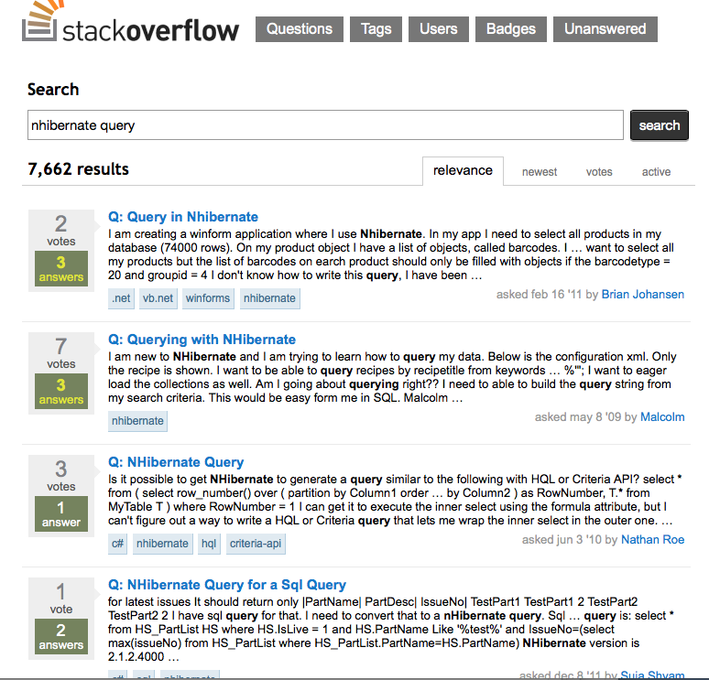
And because developers spent their time on…

Slide 33
It seems that after a while we have still a monolith
Notes:
Explain what is monolith

Slide 34
But decoupled ☺
Notes:
Explain what is monolith

Slide 35
We need more data on UI and different views per user…

Slide 36
But our model doesn’t support it
Every time we add a new view our model is broken…
Views are slower. Users complain…

Slide 37
Your reads from writes separate. Herh herh herh.
CQRS, you will do !

Slide 38
We have to think about it…
Time to wrap up…

Slide 39
Lesson learnt 2
Domain centric, refactorable and evolvable
Simple architecture, does not scale, hard to maintain, often monolithic
Recipe 2:
n-layered architecture with DI
Recipe 1:
Basic layered
architecture

Slide 40
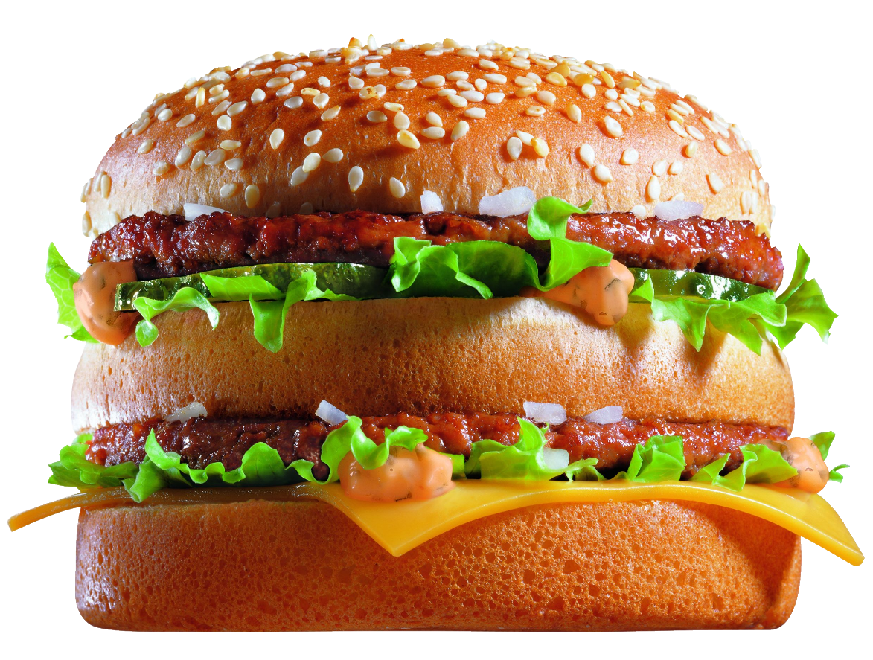
N-layered architecture with DI
Recipe 2
UI
Difficulty:
Time: reasonable
Preparation:
One must know OOP concepts and the best would be also to be aware of SOLID principles…
OrderController
OrderViewModel
OrderMapper
IOrderMapper
Order
Ingredients
OOP skills With SOLID principles would be event better ORMs and IOCs Some infrastructure pieces (DB, etc.)
SqlOrderRepository
IOrderRepository
DB
Client reviews
Can be set up rather quickly Easy to understand Can be tested | Can lead to unmaintainable monolith code blocks Not easily evolvable for quickly changing business requirements Not scalable Not performent if charge gets bigger

Slide 41
Where we’ve been?
Ah yeah…CQRS stuff

Slide 42
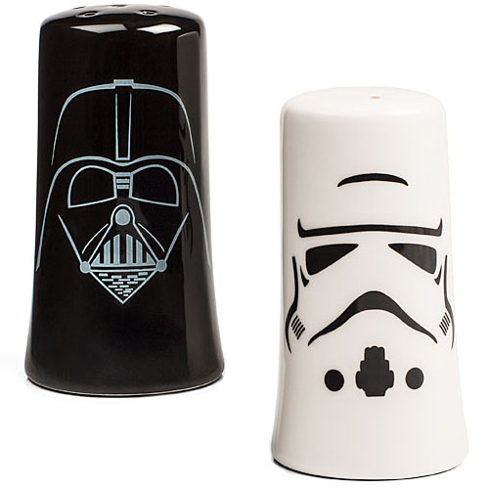
What is CQRS?
CQS applied to architecture = CQRS
Split Read from Writes

Slide 43
Architecture v3
Command
Query
UI
Application service
Read Model
Domain
Repository
DB Write DB Read

Slide 44
Architecture v3 bis
Command
Query
UI
Application service
Read Model
Domain
Repository
DB Write
DB Read
denormalized

Slide 45
Wow, the speed of views has increased
We can scale up read and write side independently
Easy to handle more business request about views and queries in denormalized DB

Slide 46
Even of it’s better we still have problems
Why we have impacts between different business lines?
Why it takes so much time for a new feature? And we always don’t get exactly what we want. There is always a confusion.

Slide 47
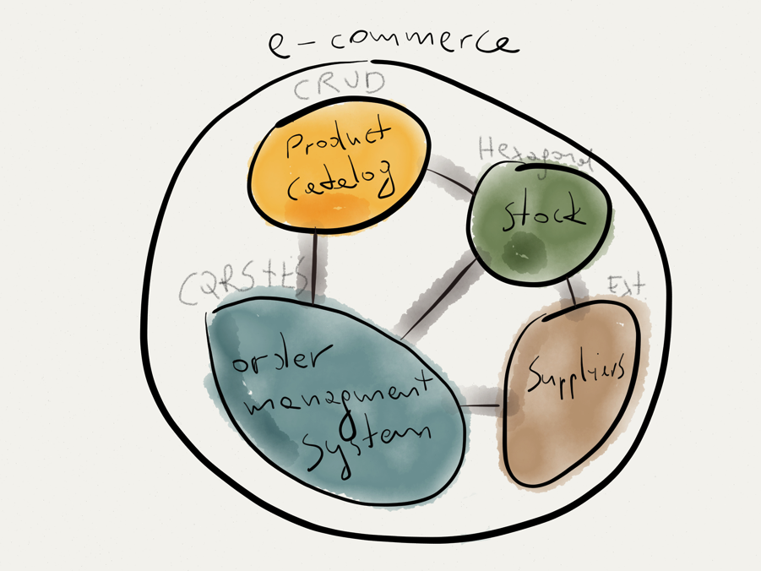
Integration inside of the business
CRUD events ?
CQRS not a top level architecture
Notes:
Where it should be used ? Where there is a value
Concurrent domain / Performances optimizations

Slide 48
Domain A
Domain B
Domain C
Domain D
Web / Application Tier
Composite UI
UI
DDD layered application
Write model
Readmodel
Legacy application
Data Access Layer
Background server Tier
Storage Tier
CRUD architecture (simple non-core domain functionality)
DDD (core domain functionality)
CQRS (core domain functionality)
Legacy subsystem

Slide 49
How to know where to put the effort?

Slide 50

What is the strategic advantage of my company?

Slide 51
Order management system is our strategic goal…

Slide 52
Great then we know where to put our effort…

Slide 53
But how do we find the best model for a business…

Slide 54
To them about events talk.
Find it meaningful, will they. Yeesssssss.

Slide 55
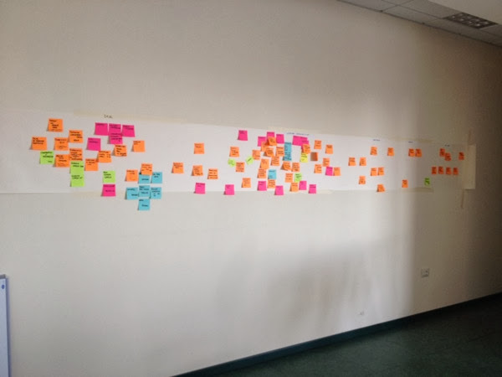
The quest has started
Event Storming = Domain Discovery Tool
source : Brandolini http://bit.ly/1s1dwoB
Notes:
It's about communication and not design

Slide 56
Events, that’s the way we think about it!

Slide 57
From events, to aggregates…It’s DDD!

Slide 58
Domain Driven Design
It’s much more than just commands and events
Ubiquitous Language
Bounded Context
Context Map
Domain Event
Aggregates
Notes:
Look no repositories
At a high level, a context map can help you understand the integration between the different bounded contexts and the events involved

Slide 59
We need a new feature concert ticket sell

Slide 60
Done!

Slide 61
System is unusable users are blocked!!!

Slide 62
Ah no, what to do?

Slide 63
Express business intent in commands and facts in events, you will.
Make events asynchronous, you will. Herh herh herh.

Slide 64
We have to think about it…
Time to wrap up…

Slide 65
Lesson learnt 3
Decoupled and easy to integrate with external systems
Domain centric, refactorable and evolvable
Simple architecture, does not scale, hard to maintain, often monolithic
Recipe 3:
Hexagonal with basic CQRS
Recipe 2:
n-layered architecture with DI
Recipe 1:
Basic layered
architecture

Slide 66
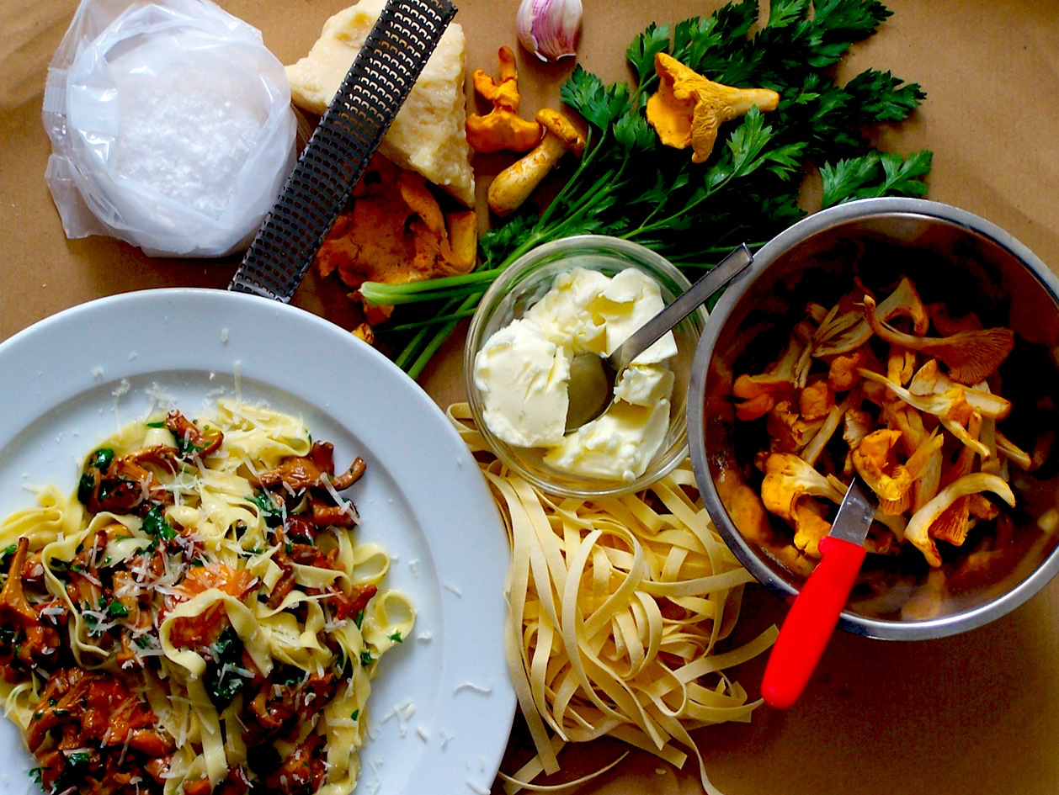
Basic CQRS
Recipe 3
Difficulty:
Time: mid-term
Preparation:
Establish a ubiquitous language with your domain experts and express it in the code
UI
Application service
Read Model
Domain
Ingredients
OOP skills SOLID principles Domain Driven Design would be a big advantage
Repository
DB Write
DB Read
denormalized
Client reviews
Scale out read from writes independently Can handle more business request about queries More maintainable code Even easier to test | Users still can be blocked read and write are synchronous Not so performent for big charges

Slide 67
Where we’ve been?
Ah yeah commands and events…asynchronous

Slide 68
Command, it’s business intent like “Place Order”
Event, it’s business immutable fact like “OrderPlaced”

Slide 69
Architecture v4
Command
Event
Dependency
UI
Command Bus
Read Model
Application service
Another context application
Command Handler
Event Bus
Read model generator
Domain
Repository
DB Read
DB Write

Slide 70
Architecture v4’
Command
Command Bus
Event
Dependency
UI
Event Bus
Read Model
Application service
Application service
Read Model
Command Handler
Command Handler
Read model generator
Domain
Repository
Domain
Repository
Read model generator
DB Read
DB Write
ACL
DB Write
DB Read

Slide 71
Architecture v4’’
Command
Command Bus
Event
Dependency
UI
Event Bus
Read Model
Application service
Application service
Command Handler
Command Handler
Read model generator
Domain
Repository
Domain
Repository
DB Read
DB Write
ACL
DB Write

Slide 72
But there is a trap. Views are not refreshed immediately

Slide 73
CAP Theorem*
CQRS Ingredients
Consistency:
A read sees all previously completed writes
Availability:
Reads and writes always succeed
Partition tolerance:
Guaranteed properties are maintained even when network failures prevent some machines from communicating with others
A system can be either CP, AP. CA is not coherent.
* Eric Brewer

Slide 74
CAP Theorem
CQRS Ingredients
CP AP
Node 1
Node 2
Node 1
Node 2
Data
Data
Data
Data

Slide 75
Eventual Consistency
CQRS Ingredients
« A key benefit of embracing eventual consistency is to remove the requirement for using distributed transactions »
Users deal every day with Eventual Consistency

Slide 76
But there is still a trap with event synchronization

Slide 77
Write side
Read side
UI
Write Model
Read Model
Read data
Update write side data store
Update read side data store
DB Write
DB Read
Transaction Scope

Slide 78
Write side
Read side
UI
Write Model
Read Model
Update write side data store
Send message to update read side data store
Read data
Event Bus
DB Write
DB Read
Reliable messaging
Transaction Scope

Slide 79
Write side
Read side
UI
Write Model
Read Model
Update
write side
data store
Read data
Event Bus
DB Write
DB Read
Reliable messaging
Send message to update read side data store
Transaction Scope

Slide 80
I would like to know if user before placing an Order removes Items if we propose them more useful articles with our recommendation system

Slide 81
That’s a tricky question. We don’t have a history.

Slide 82
All you need, you have.
Use your events, you will. Yeesssssss.

Slide 83
We have to think about it…
Time to wrap up…

Slide 84
Lesson learnt 4
Easily scalable and preferment
Decoupled and easy to integrate with external systems
Domain centric, refactorable and evolvable
Simple architecture, does not scale, hard to maintain, often monolithic
Recipe 4:
Hexagonal’ish with CQRS + DDD
Recipe 3:
Hexagonal with basic CQRS
Recipe 2:
n-layered architecture with DI
Recipe 1:
Basic layered
architecture

Slide 85
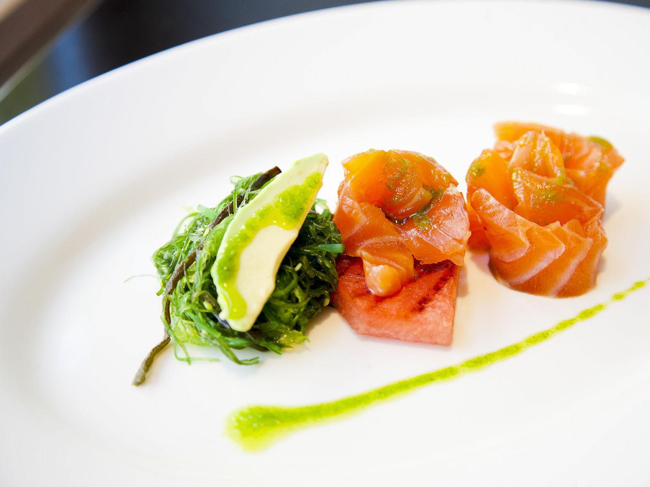
Basic CQRS + DDD + Async
Recipe 4
Command Bus
UI
Difficulty:
Time: long term
Preparation:
Gather business intent in form of Commands, map it to business events and synchronize everything async.
Event Bus
Read Model
Application service
Application service
Command Handler
Command Handler
Read model generator
Domain
Repository
Domain
Repository
Ingredients
Good OOP skills SOLID principles Domain Driven Design modeling Good knowledge of messaging infrastructure
DB Read
DB Write
ACL
DB Write
Client reviews
Handles concurrent domains Scale out read from writes independently Can handle more business request about queries Business process explicit Even easier to test | Many moving parts Sometimes integration points between systems are harder to grasp Bad things can happen if no integration events command are stored

Slide 86
Where we’ve been?
Ah yeah storing events…

Slide 87
For legal thing, we would like an audit log

Slide 88
If we got a time machine…

Slide 89
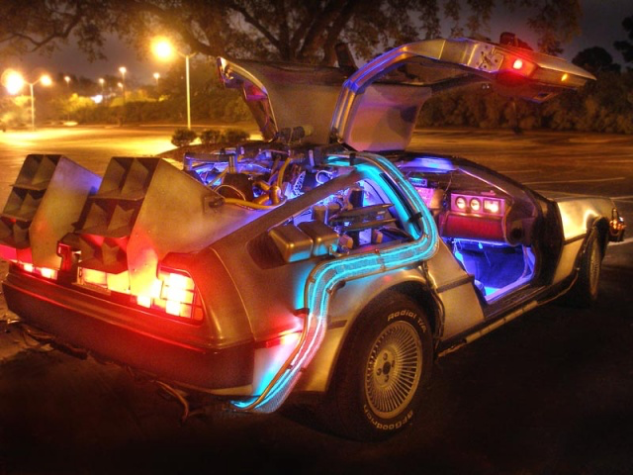
Yes you have it. Events = facts

Slide 90
Event Sourcing
CQRS Ingredients
Event as a storage mechanism
Order placed
Order
Order line Item
Added shipping info
Removed 2 items 245
Shipping information
Added 3 items 455
Added 2 items 245
Order Created
Notes:
Append only system

Slide 91
Event Sourcing
Rolling snapshot
Order placed
Added shipping info
Snapshot
Removed 2 items 245
Put on stack
Added 3 items 455
Added 3 items 455
Removed 2 items 245
Snapshot
Added shipping info
Order placed
Added 2 items 245
Order Created
Notes:
Append only system

Slide 92
Command
Event
Dependency
UI
Command Bus
Read Model
Application service
Another context application
Command Handler
Event Bus
Read model generator
Domain
DB Read
Event Store

Slide 93
Command
Event
Command Bus
Dependency
UI
Event Bus
Read Model
Application service
Application service
Read Model
Command Handler
Command Handler
Read model generator
Domain
Domain
Repository
Read model generator
DB Read
Event Store
ACL
DB Write
DB Read

Slide 94
Command
Event
Dependency
UI
Command Bus
Read Model
Application service
Another context application
Command Handler
Event Bus
Domain
Event Store

Slide 95
Our system seems to be on the right track now !

Slide 96
Lesson learn 5
Resilient
Easily scalable and preferment
Decoupled and easy to integrate with external systems
Domain centric, refactorable and evolvable
Simple architecture, does not scale, hard to maintain, often monolithic
Recipe 5:
Hexagonal’ish with CQRS + DDD + ES
Recipe 4:
Hexagonal’ish with CQRS + DDD
Recipe 3:
Hexagonal with basic CQRS
Recipe 2:
n-layered architecture with DI
Recipe 1:
Basic layered
architecture

Slide 97
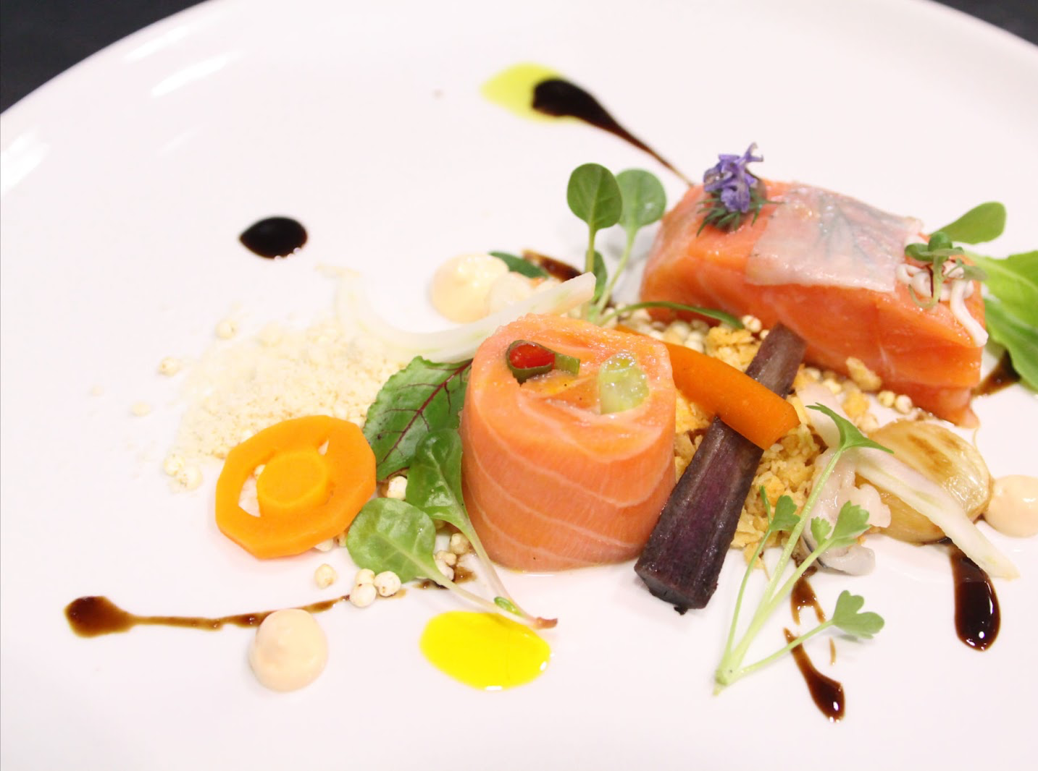
Basic CQRS + DDD + ES
Recipe 5
Command Bus
UI
Difficulty:
Time: long term
Preparation:
Make your events talk.
Event Bus
Read Model
Application service
Application service
Read Model
Command Handler
Command Handler
Ingredients
Good OOP skills SOLID principles Domain Driven Design modeling Good knowledge of messaging infrastructure Functional thinking
Read model generator
Domain
Domain
Repository
Read model generator
DB Read
Event Store
ACL
DB Write
DB Read
Client reviews
Handles concurrent domains Scale out read from writes independently Can handle more business request about queries Business process explicit Audit log, testing and infinite business views on data | Many moving parts Sometimes integration points between systems are harder to grasp Bad things can happen if no integration events command are stored

Slide 98
Maslow architecture pyramid
Not official, just my own trip
Culinary art
Fine food
Home cooking
Fast food and frozen food
Basic ingredients like milk, bread, meat
Resilient
Easily scalable and preferment
Decoupled and easy to integrate with external systems
Domain centric, refactorable and evolvable
Simple architecture, does not scale, hard to maintain, often monolithic

Slide 99


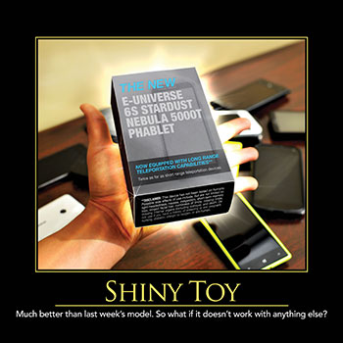

What CQRS is not?
CQRS Basics/From CQS to CQRS

Slide 100
Is CQRS for me?
CQRS Basics/From CQS to CQRS
What kind of problem do I try to solve ?
Collaborative domain
Locking the data without blocking the user
Read data scalability
Performance optimization
Complex workflows / Temporal data / Stale data

Slide 101
There is more
Aggregates
Validation
Uniqueness checking
Existence checking
Replaying of events (Event Sourced)
Long running workflows
Optimization
Notes:
Long running process: saga and process manager
Optimization : command without messaging, commands in parallel

Slide 102
Long running workflows
CQRS Deep Dive Cooking
How do I know if I need one?
Difference between Saga and Process Manager?

Slide 103
Order Aggregate
1. Place Order
2. OrderPlaced
7. OrderConfirmed
3. Make reservation
Order Process Manager
Stock Aggregate
Client
7. OrderConfirmed
4. ItemsReserved
7. OrderConfirmed
5. Make payment
6. PaymentAccepted
Payment Aggregate

Slide 104
Questions ?

